Slide 1
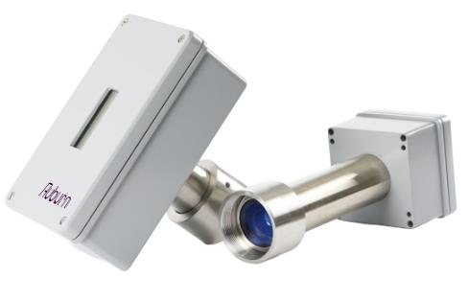
PM Laser
Optical Forward Scatter

Slide 2
Agenda
Product Overview
Application Considerations
Value Proposition
Configuration
Install & Operation
Supporting Software

Slide 3
Product Overview

Slide 4
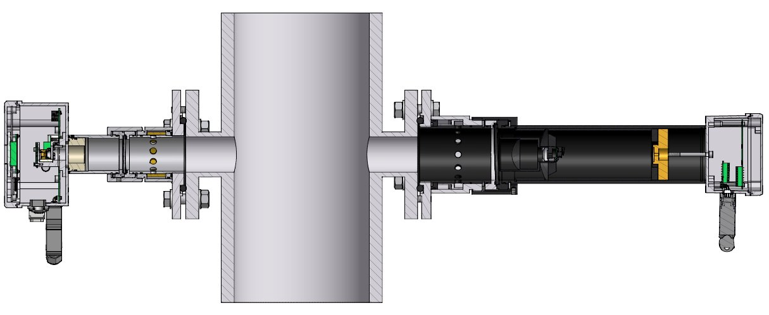
PM Laser Product
Transmitter
Receiver
Particulate scatters and absorbs incident light
Amount of direct transmitted light and forward scattered light depend on the amount of dust
Red laser beam transmitted through dust volume, light signals detected with photodiodes.

Slide 5
Forward Scatter and Transmission Monitoring Principle
Forward scattered light
Back scattered light (Inferior)
Laser
Dust Particles
Reduced light

Slide 6
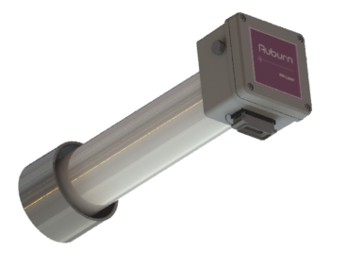
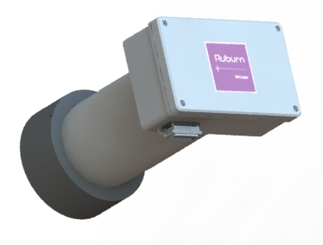
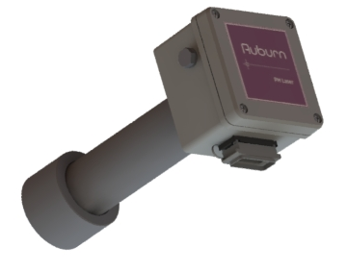
Model Types
Medium-Path
Receiver
Long-Path
Receiver
Extra Long-Path
Receiver
OPL: 2 – 10ft (0.5 - 3m)
OPL: 10 – 20ft (3 - 6m)
OPL: 20 – 33ft (6 - 10m)
*Transmitter is identical for all model types, matching receiver flange.

Slide 7
Specifications
Parameter | Spec
Process Temperature (max.) | Up to 1292⁰F (700⁰C)
Process Pressure (max.) | Up to 21psi (1.5bar)
Optical Path Length | 1.6 – 9.8ft, 9.8 - 19.6ft, 19.6 - 32.8ft (0.5 – 3m, 3-6m, 6-10m)
Resolution | 0.05 mg/Nm³
Enclosure Rating | IP66 (Outdoor)
Outputs | Default: Analog (4-20mA), Modbus TCP

Slide 8
Features
Continuous in situ monitoring
High sensitivity and accuracy
Extended stack measurement range
High temperature resistance
Fast response time
  Continuous: ≥ 2 sec.
  Pulse detection: ≥ 50ms.
Direct mode dynamic range 0 – 10,000 mg/Nm³
Scattered mode dynamic range 0 - 200mg/Nm³ (Dust dependent)

Slide 9
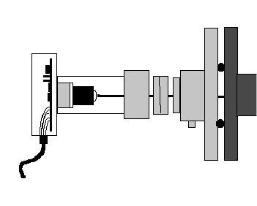
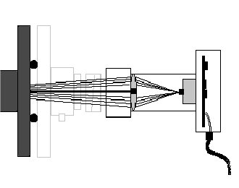
Direct Mode Operation
Usable for high dust concentration (up to 10g/Nm^3)
Dust on the optical windows will influence the measurements.
Not as accurate as the scattered mode at low dust concentrations.
Will measure dust over the whole length of the path.
Transmitter
Receiver
Reduction of light.

Slide 10

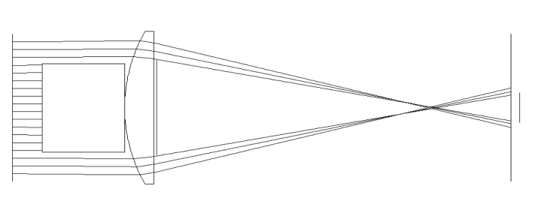
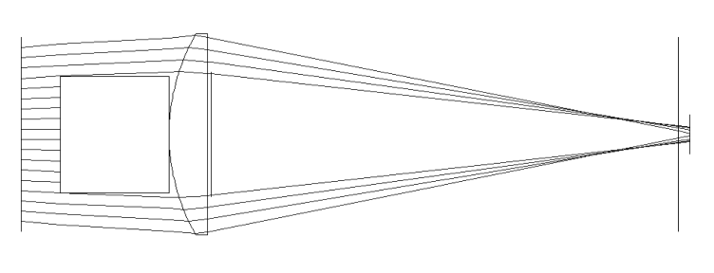
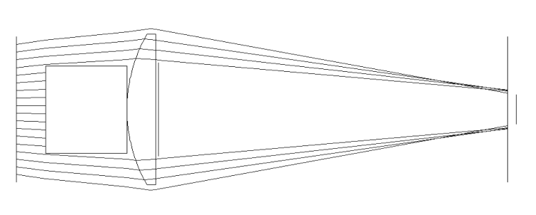
Scattered Mode Operation
High sensitivity for low dust concentrations (<0.5mg/Nm³)
Not sensitive for dust on the optical windows
Immunity for dust on the optical windows obtained by:
Normalize the scattered dust signal with the direct signal.
Optical design that only ”looks” at the sensitive area of the dust path.
Sensitive Area
Transmitter
Receiver
Response
Far away
In sensitive area
Near receiver

Slide 11
Application Considerations

Slide 12
Application Considerations
Fog and water droplets will be measured as dust
High temp >1292°F (700 °C) will make the dust glow and will interfere with the red laser light.
Too thick stack walls will block the sensitive area in scattered mode.
Correct alignment is important to get good results.

Slide 13
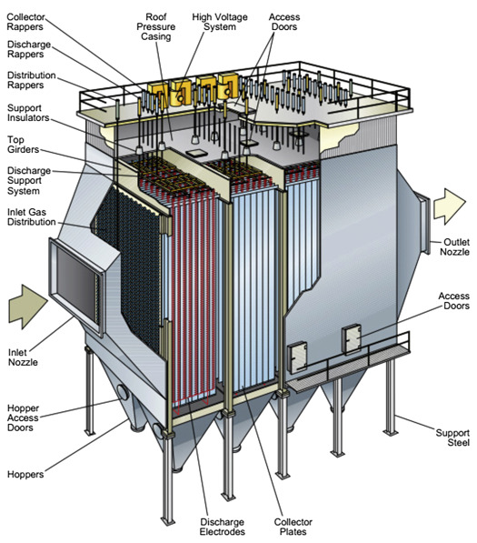
Application Considerations
Electrostatic Precipitation, or ESP
  Very low particulate concentrations
  Measures across the entire ESP path length
  More tolerant of dust accumulation by the window
  Contactless measurement ensures reliability and less electrical noise

Slide 14
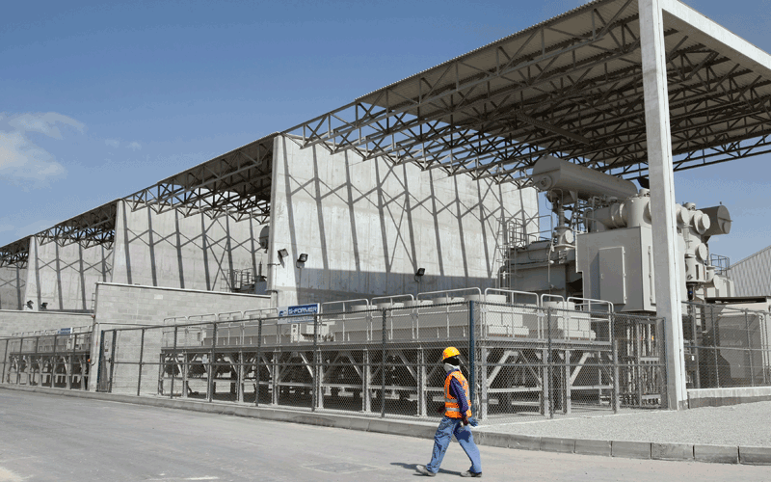
Application Considerations
Aluminum Plants
  GTC and FTC outlets often operate with ultra-low PM levels
  Resistant to HF and corrosive gases due to fused-silica windows
  Full process coverage for non-uniform particulate distribution
  Contactless measurement is ideal for abrasive, high-temperature ducts

Slide 15
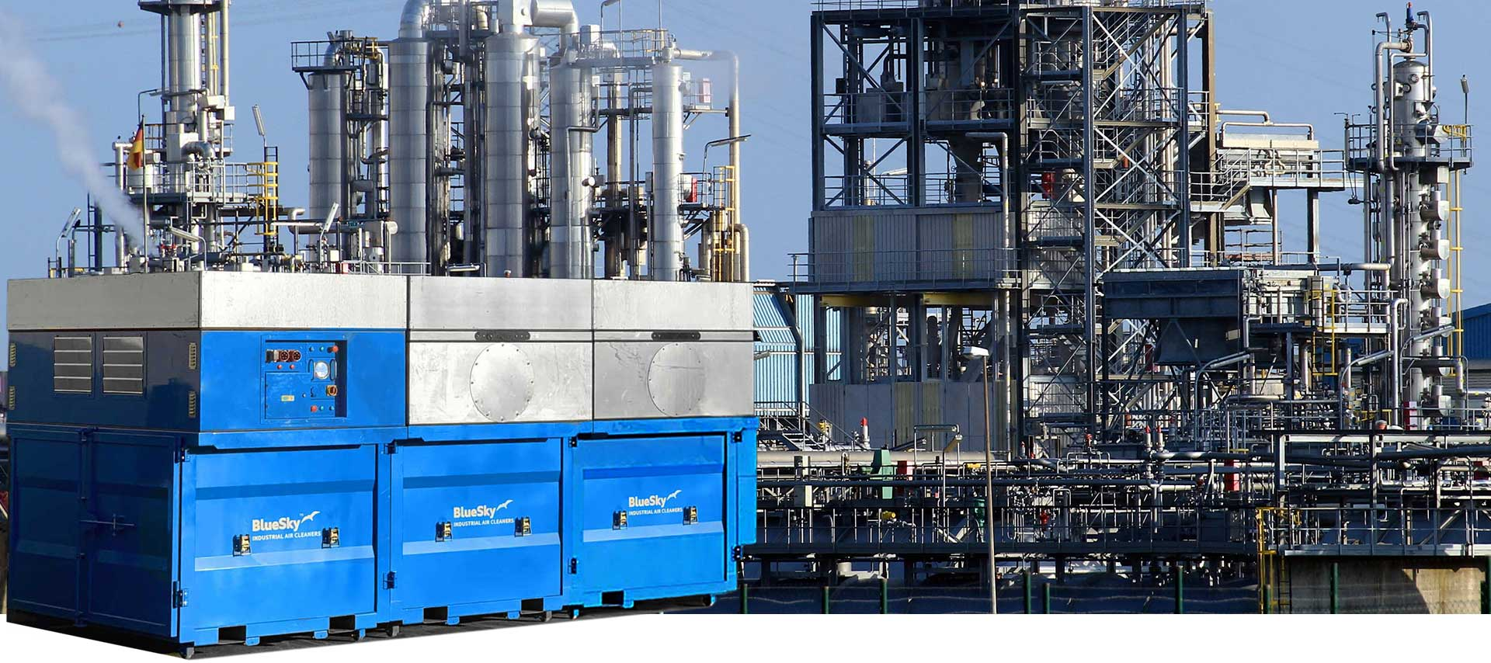
Application Considerations
Oil & Gas
  Measure small PM levels from clean combustion
  Heater stacks, cracker furnaces, and coker units often have dry emissions with fine particulate
  Requires full-stack particulate averaging and ATEX, IECEx, UKEx certified instrumentation
  Refinery furnaces, SRU incinerators, reformer/heater stacks, and thermal oxidizers operate at high flue‑gas temperatures that exceed the limits of less robust sensors.

Slide 16
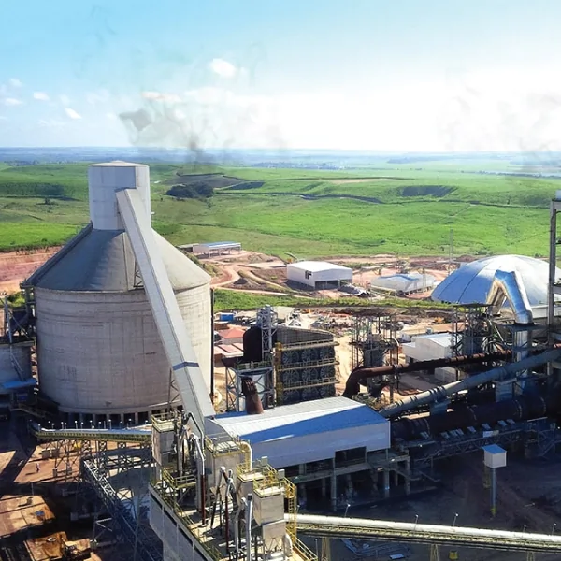
Application Considerations
Cement
  Electrodynamic and triboelectric probes are not suitable for highly abrasive processes or extremely high temperatures. Cross‑stack optics avoid intrusion and withstand extreme kiln/coal‑mill exhausts.
  Cement emissions vary throughout the process. A sensor that maintains accuracy despite dust size changes reduces calibration drift and compliance risk.
  Forward scatter is widely used in cement groups and OEMs

Slide 17
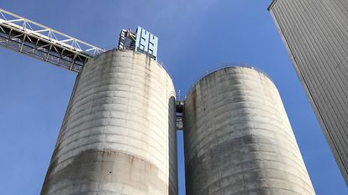
Application Considerations
Power Plants
  Including ESP processes, post‑filtration exhaust often has low mg/Nm³ PM
  Most systems produce a mix of coarse and fine particulate, demanding baghouse leak detection, burner performance feedback, and mill condition monitoring.
  Requires early detection of rising dust levels to prevent dust explosions, filter failures, and worker exposure spikes
  Forward scatter instruments avoid the sensitivity loss caused by backscatter optic contamination, enabling higher measurement stability.

Slide 18
Value Proposition

Slide 19
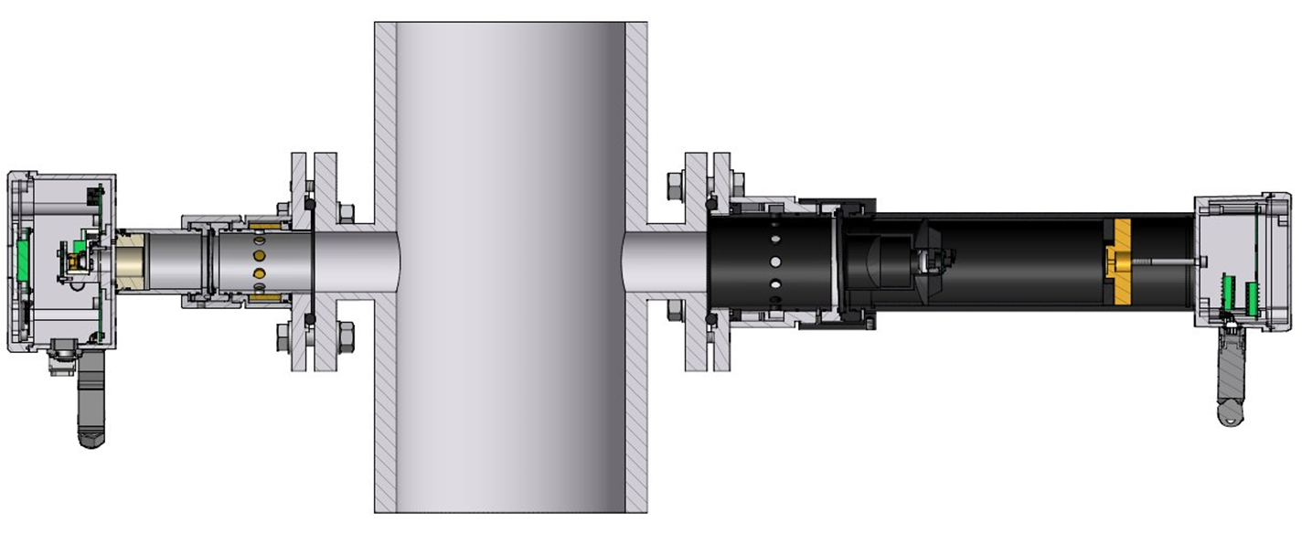
Value Proposition
Forward‑scatter measurement delivers unmatched low‑dust sensitivity, enabling accurate detection even at concentrations of 0.05 mg/Nm³.
  Higher sensitivity for fine particulates compared to backscatter.
  Ideal for clean‑stack, regulatory, or low‑opacity applications requiring precision.
  Measures across the full optical path, improving data quality and representativeness.

Slide 20
Value Proposition
Why accuracy matters: small deviations at low concentrations greatly impact compliance and safety.
  High sensitivity to small particle sizes (>1 μm).
  Stable, repeatable measurements using dual‑mode (transmission + scatter) technology.
  Robust performance in harsh, dusty, and high‑velocity environments.

Slide 21
Value Proposition
Operators value a monitor that doesn’t require constant attention. Forward‑scatter implementation reduces downtime through:
  Non‑contact design — eliminates probe fouling.
  Scattered mode unaffected by window dust buildup — maintains measurement stability.

Slide 22
Value Proposition
Forward‑scatter monitor directly solves common particulate‑monitoring pain points:
  Inaccurate readings at low dust levels → solved via high‑sensitivity forward scattering.
  Frequent maintenance & downtime → replaced with non‑contact, low‑maintenance design.
  Regulatory fines & audits → traceable, real‑time data with automated QA features.
  Complex installation → cross‑stack system optimized for a range of optical path lengths.

Slide 23
Configuration

Slide 24
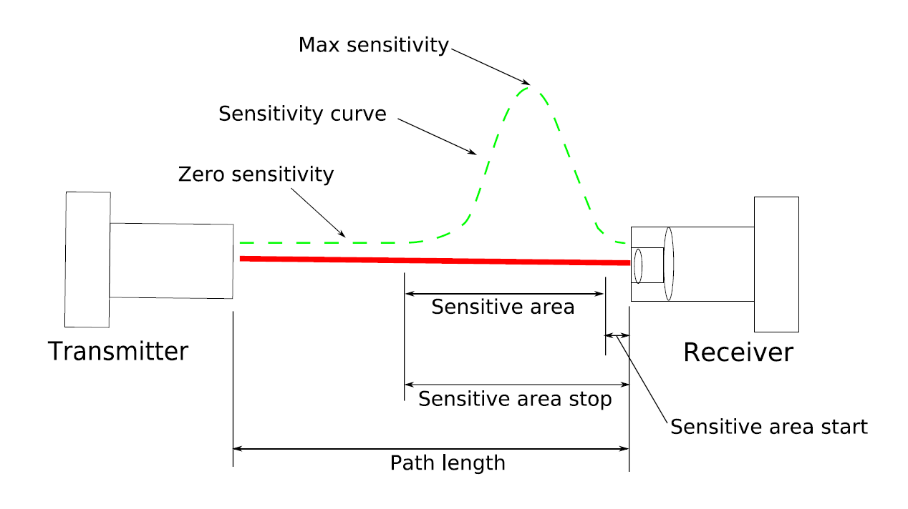
Configuration - Optical
Example:
Path Length : 1.5m
Sensitive Area Start : 10cm (.1m)
Sensitive Area Stop : 90cm (.9m)
Optical
.9m
.1m
1.5m

Slide 25
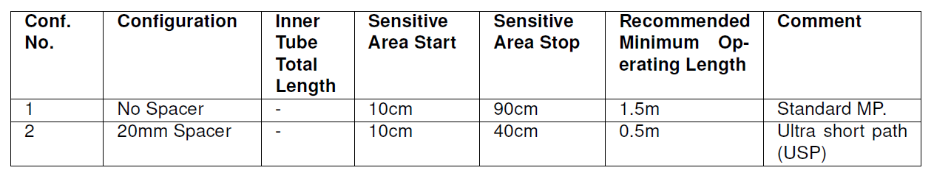
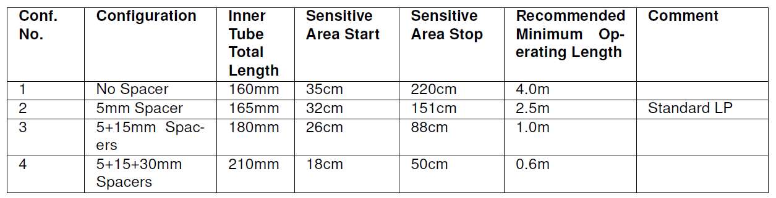
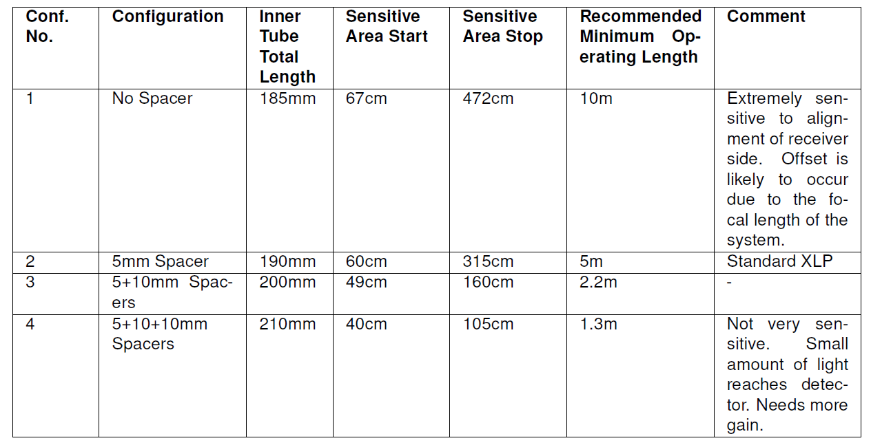
Configuration - Optical
Optical
MP
LP
XLP

Slide 26
Configuration – Selection Guide
Amount of Dust:
  For small amount of dust, you should select scattered mode measurements, and for high dust concentration, direct mode should be used.
Dust Path:
  The length of the dust path is of importance when selecting between the different models, and when selecting the optical configuration and gain for each model.
  These are guiding numbers only, as the optical configuration can be changed in the instruments. The max lengths are also recommendations and basically have to do with the mechanical stability of the installation. This is to allow more vibration and movements for the laser beam at the receiver side. Also, the sensitive areas are stretched longer out into the path to measure a bigger part of the stack.

Slide 27
Configuration – Selection Guide
Length of Mounts:
  Some places there are thick walls on the pipe. This means that even if the actual measuring path is small, it might not always be a good solution to select a short path instrument, as the sensitive area in such instrument might disappear inside the mounting tube.
  Remember that to obtain the technical functionality for immunity against dust on the window, it is the distance from the transmitter window to the receiver window that counts. An optical configuration that can handle less than this distance should always be selected.
  Also keep in mind that reflections inside long flange mountings could cause false readings / offset.

Slide 28
Configuration – Selection Guide
Optical Configurations:
  The optical configurations can be changed in relation to its standard setup.
  If the path length is very short you can change the optical configuration of the MP instrument to handle shorter paths. If you have a path length that is sufficient for use of a MP instrument but you suspect vibrations to be a problem, it is possible to shorten the sensitive area for a LP instrument.
  When changing the optical configuration for the instruments, the sensitivity will change. This can be corrected by increasing or decreasing the gain of the instrument, if necessary.

Slide 29
Configuration – Selection Guide
High Process Temperature:
  At high temperature, the dust will start to glow and interfere with the light caused by the laser.
  We do not recommend that the PM Laser should be used with gas temperatures above 1292⁰F (700⁰C). For gas temperatures from 932⁰F (500⁰C) to 1292⁰F (700⁰C), a red filter shall be mounted on the direct light detector

Slide 30
Installation & Operation

Slide 31
Installation - Alignment
Alignment is important!
Why? Because the instruments optical design relies on 2 factors to get good results:
Keeping the laser beam in the center of the optics
Keeping the laser beam parallel with the receiver optics
Laser
NOT OK!
Receiver
Laser
NOT OK!
Receiver
OK!
Laser
Receiver

Slide 32
Installation – Alignment
Alignment Tolerances
Instrument tolerates some deviation in alignment, but vibration & thermal movement could mean alignment problems if the alignment is not 100% after installation!
L=2-33ft (0.5 – 10m)
Small movements at transmitter side can cause large movement at receiver side!

Slide 33
Installation – Purging
Instrument tolerates a small amount of dust settling on the window, but clean air purge is required to keep the windows as clean as possible to get good results.
Air must be dry and clean!
Unclean purge air will leave a thin film of water or oil on the windows which will cause the instrument to fail in operation!
The amount of purge air will depend on the process and instrument type.

Slide 34
Operation
After the product is properly installed, setup the service software, configuring to your installation/application
Post-software setup, the instrument can be powered up
There are 4 modes to use:
  Start-up mode
  Normal mode (Operation)
  Zero/Span mode
  Fault mode
Notes:
Start-up Mode: After turning on the power the instrument runs through initializing, self-test and start-up before starting measurements.
Zero/Span Mode: Zero and span mode functionality enables the user to verify the performance of the instrument at any time during operation.
Fault Mode: Fault mode is entered when the instrument has detected a severe failure, which may permanently damage the instrument, such as overheating. In this case the instrument stops measuring the dust concentration and most instrument functions are turned off.

Slide 35
Support – Maintenance
No moving parts during operation
No need for regular replacement of parts
Self monitoring of critical parameters
Maintenance limited to visual inspection/cleaning of optical windows
Maintenance intervals can be from 3 - 9 months depending on the process.

Slide 36
Supporting Software

Slide 37
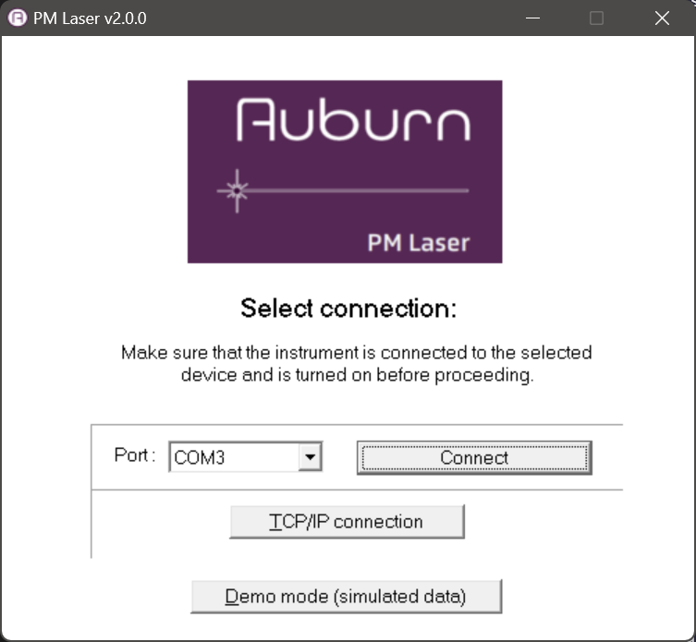
Supporting Software
Ethernet
No Instrument Required

Slide 38
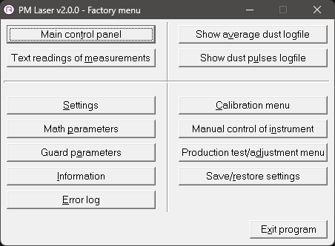
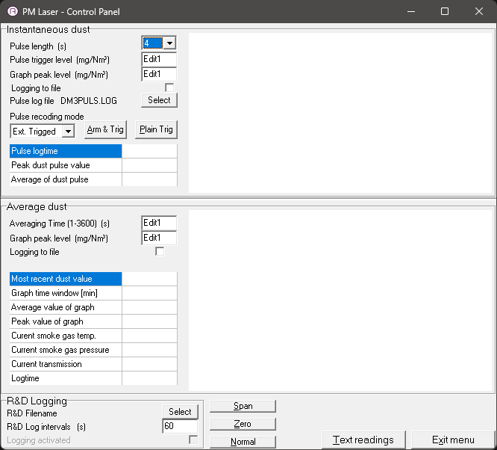
Supporting Software
To make an R&D log:
Select Filename and location.
Select logging interval in seconds.
Mark the “logging activated” field.

Slide 39
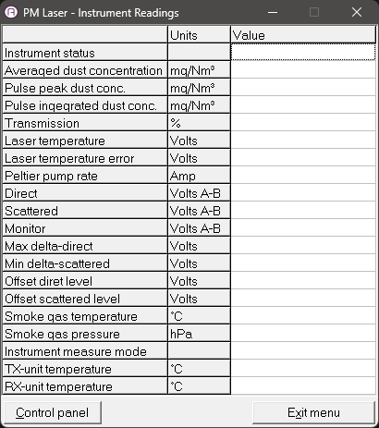
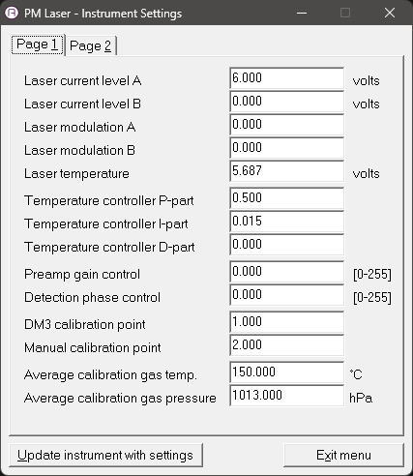
Supporting Software
Instrument readings and settings take place here

Slide 40
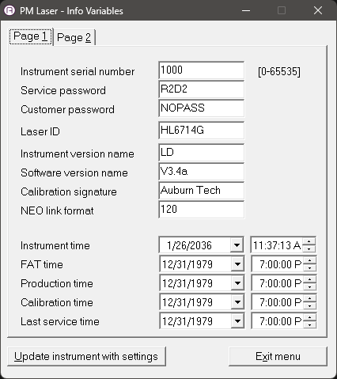
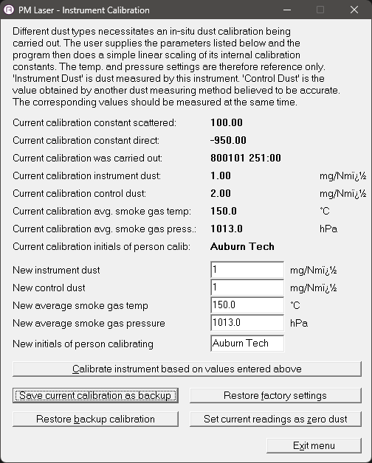
Supporting Software
Calibration is done through the service software

Slide 41
Thank you

